Slide 1
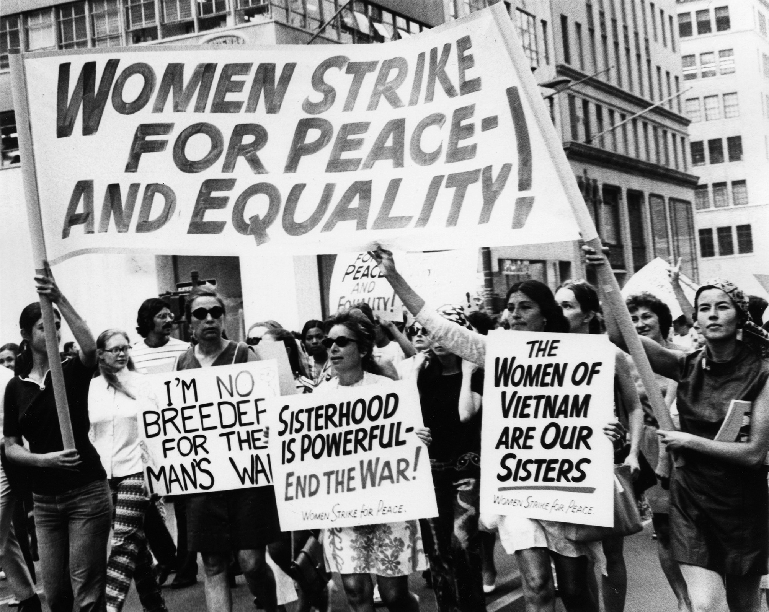
Feminist movements in 1970s-1980s
1970 in New York
1) What is Feminism? :
-Same rights as men
-Sex of an individual cannot justify different of treatment

Slide 2
2) When was the first feminist movement created? :
-3 waves of feminism:
-First (1850-1945)
-Second (1960-1970)
-Third (1970-nowdays)
3) Feminist movements in the 1970s- 1980s:
Equal Rights Amendment:
-Fight for the passage
-Ratification of the ERA
-Idea of equal rights for women
Protests:
-Lobbied and protested throughout the 1970s
-Women’s magazines
-Changements
Women’s strike for Equality:
-Strike in the USA
-Organized by the NOW
-« The unfinished business of equality »

Slide 3
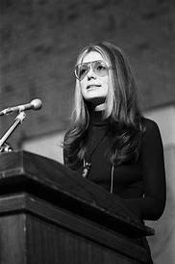
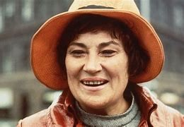
4) Important players:
Gloria Steinem:
-Born in 1934
-American feminist
-1971: founder of Ms Magazine
-A women’s magazine that eschewed articles about beauty products
Bella Abzug:
-Born in 1920 and died in 1998

Slide 4
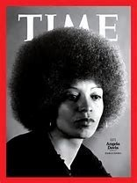
-Politician and
feminist
Angela Davis:
-Born in 1944
-Black american activist
-arrested in NY in 1970
-Because of kidapping
-Wrote « An Autobiography » in 1974

